Slide 1
Anime and Animation Society
Flip Book Animation Event

Slide 2
Outline
Explain the materials
Safety card
Basic introduction of animation
How to assemble the flip book
Prompts

Slide 3
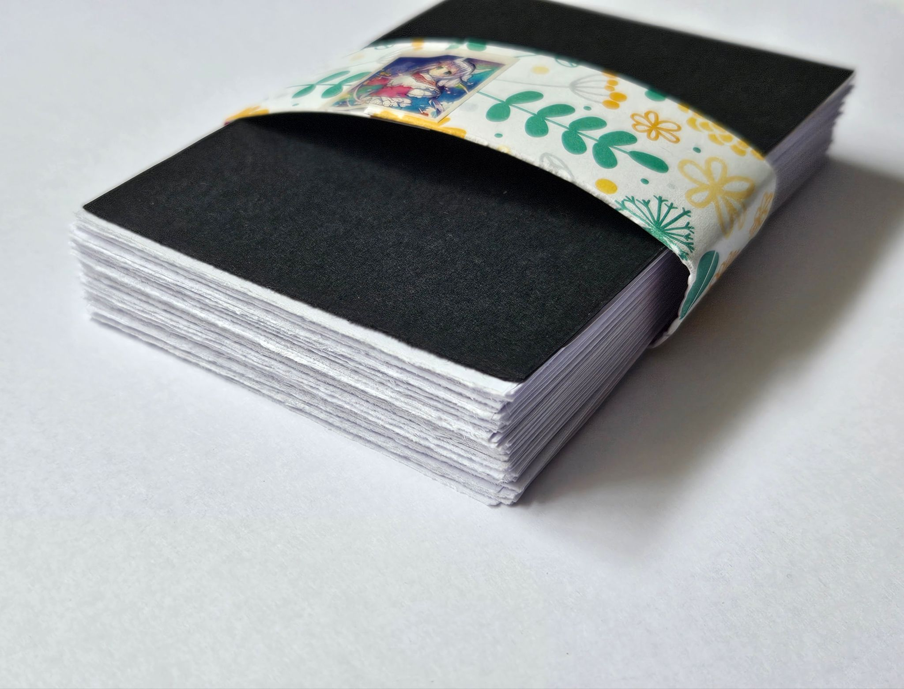
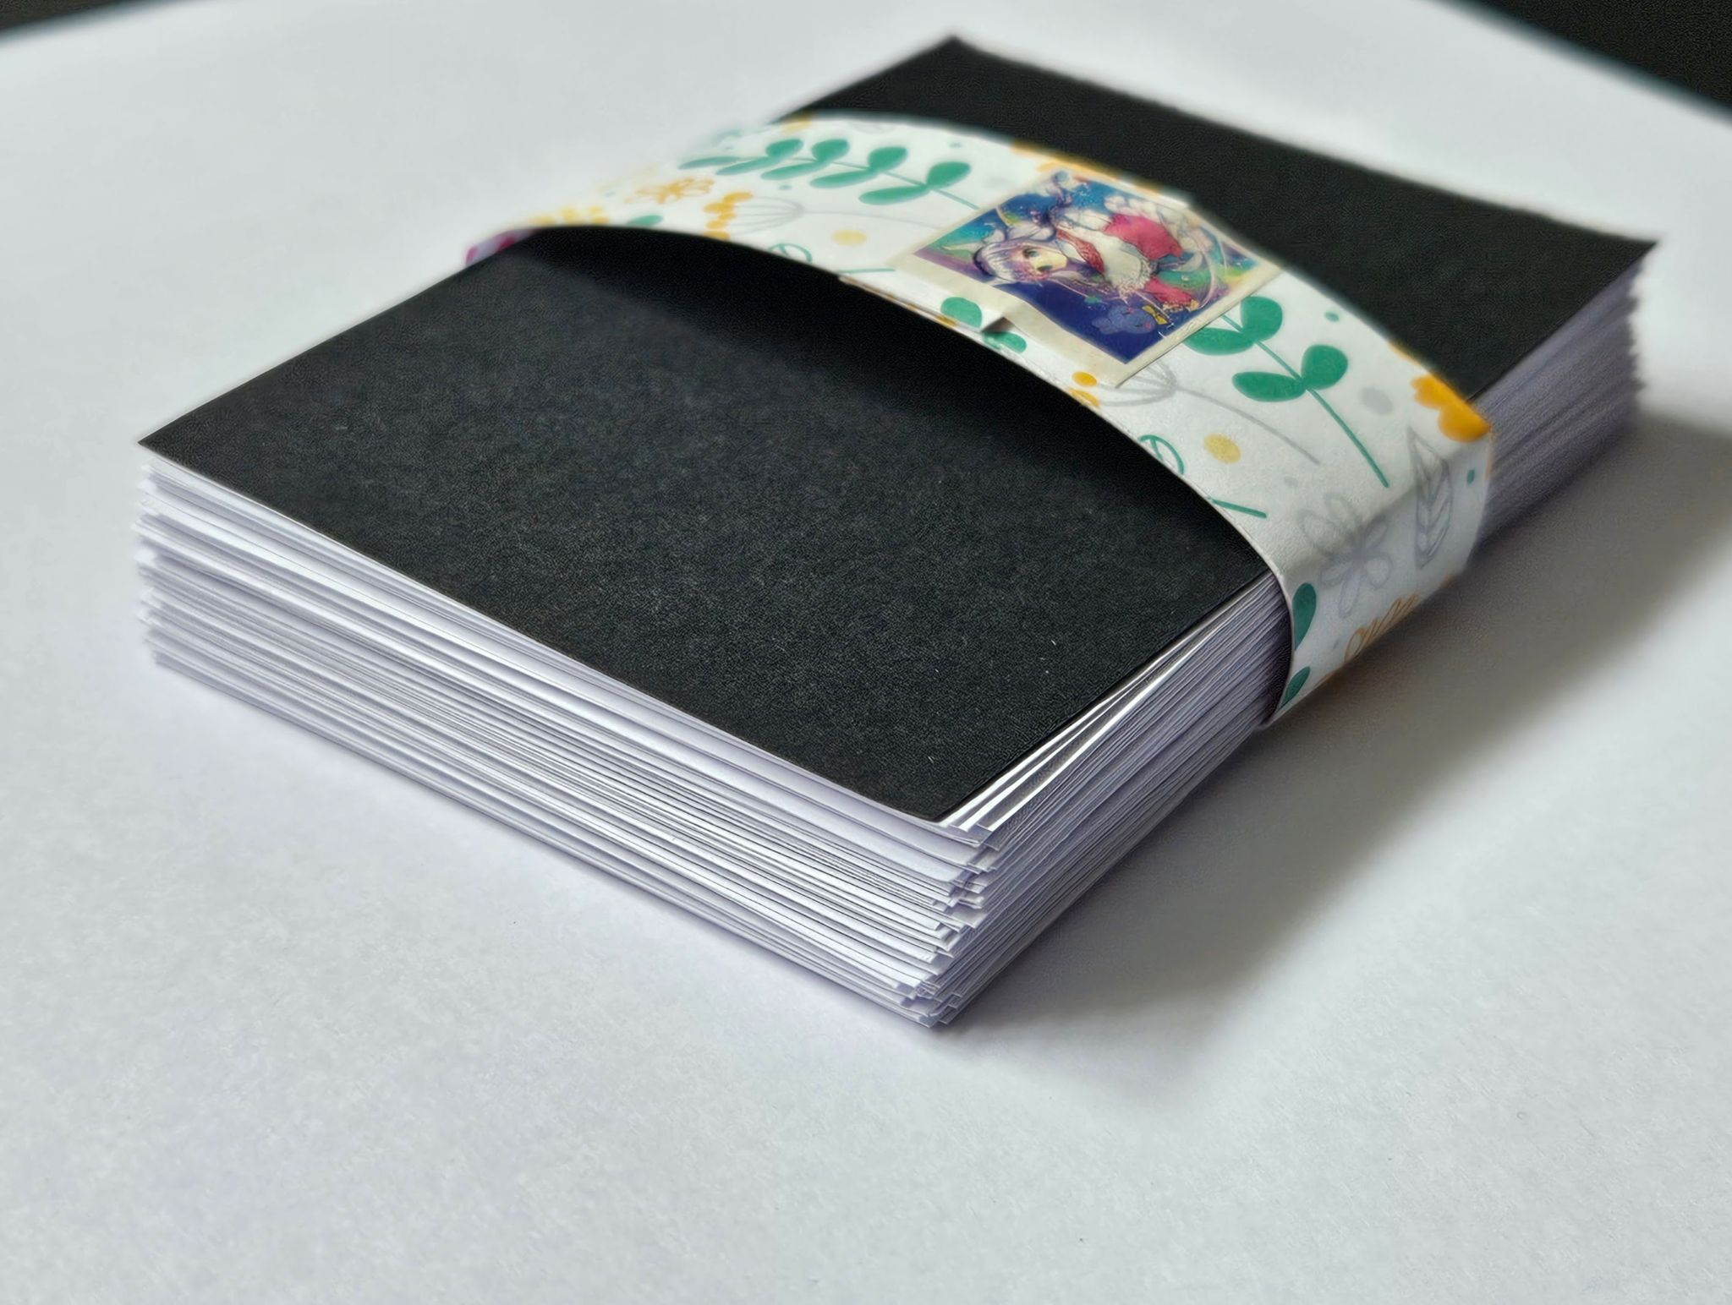
Materials
Fuzzy edge
Sharp edge
Flip book paper stack contains 1 black card and 80 drawing paper
Paper box with lid
Safety card
20 paper clips
1 pencil
2 pencil cap erasers
Sharpeners

Slide 4
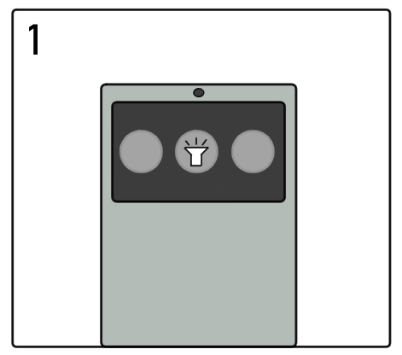
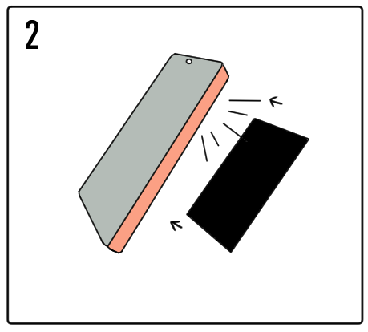
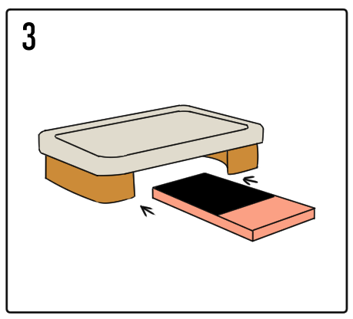
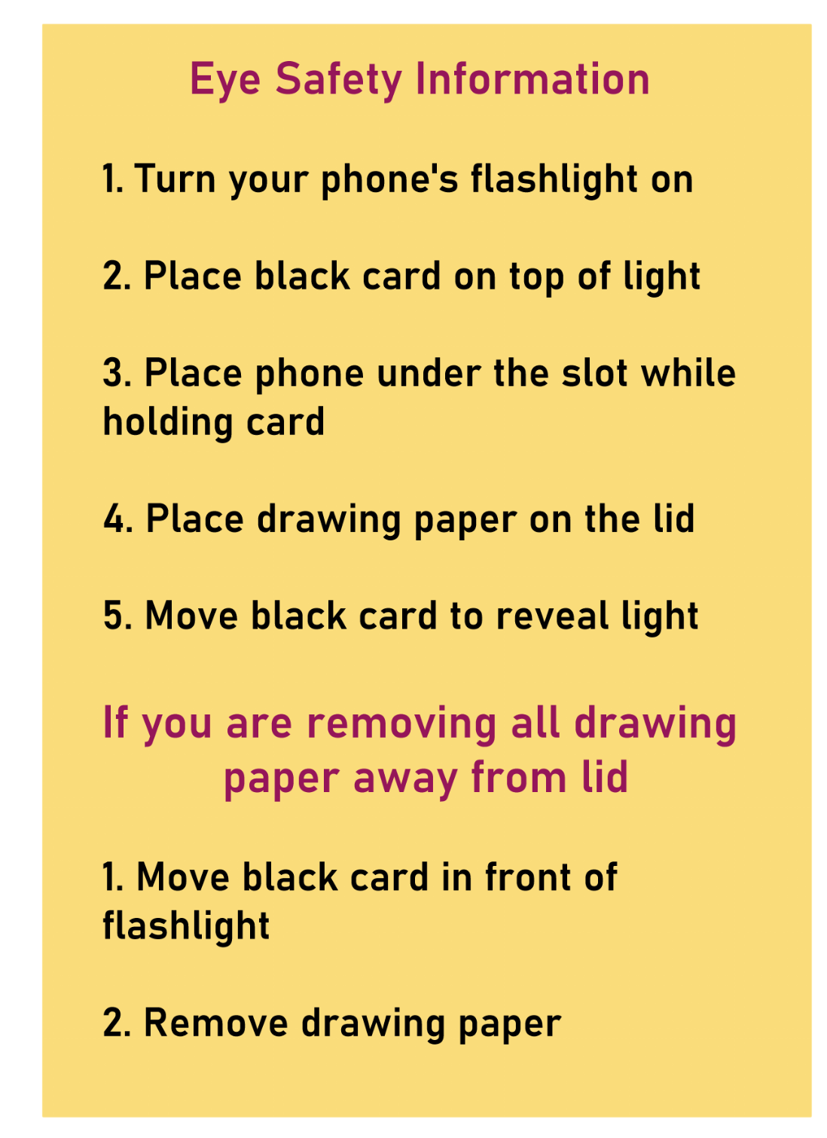
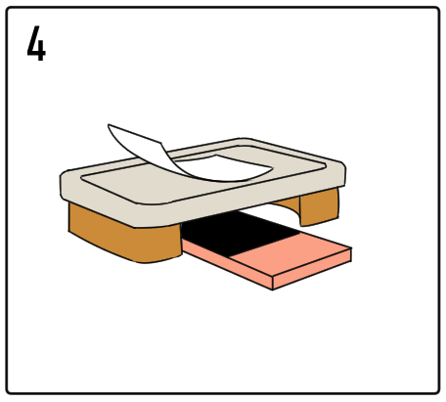
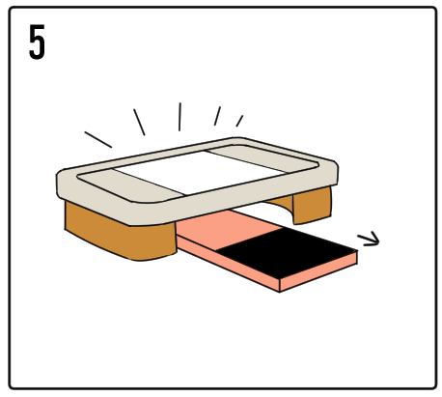
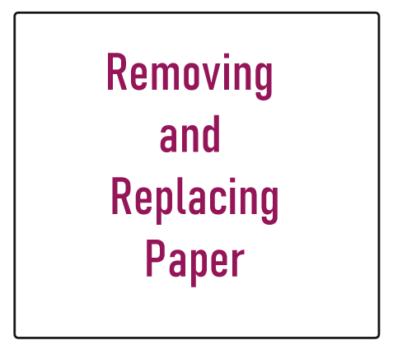
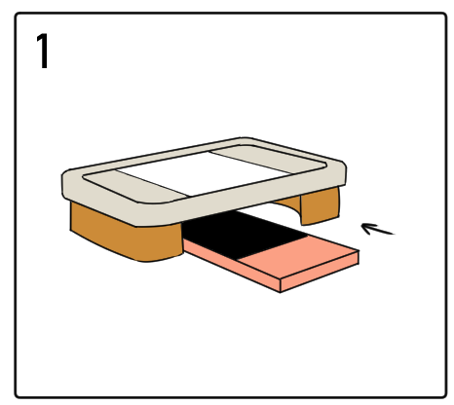
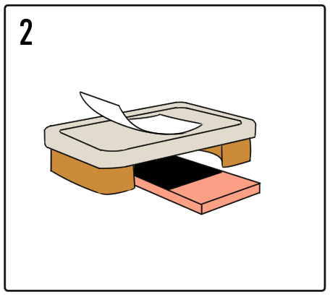
Safety Information
Steps to avoid being blinded by your phone’s light

Slide 5

The Bouncing Ball
Timing, Spacing, Ease in and out, Straight ahead or Pose to pose

Slide 6


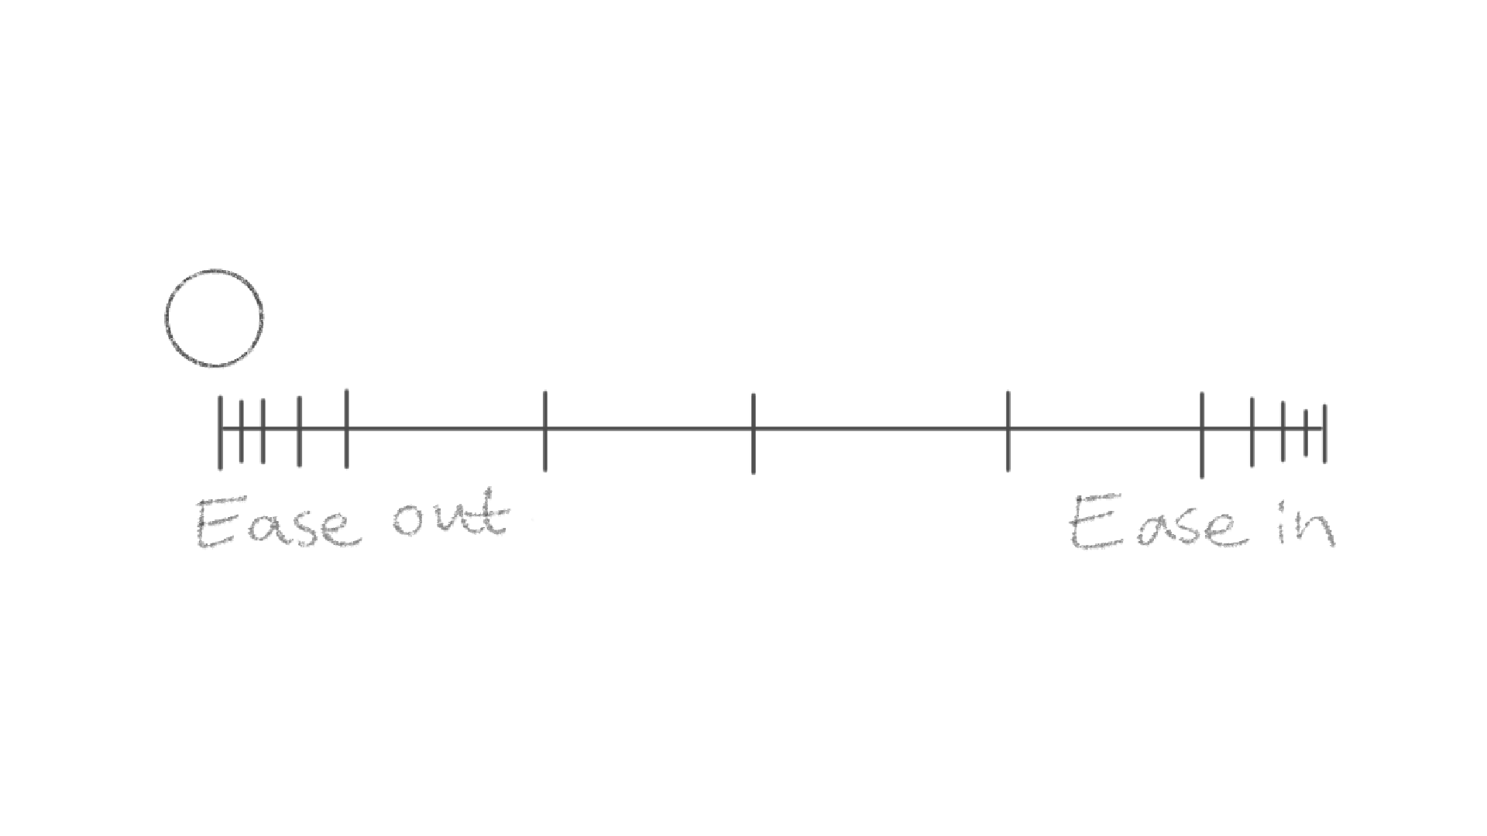
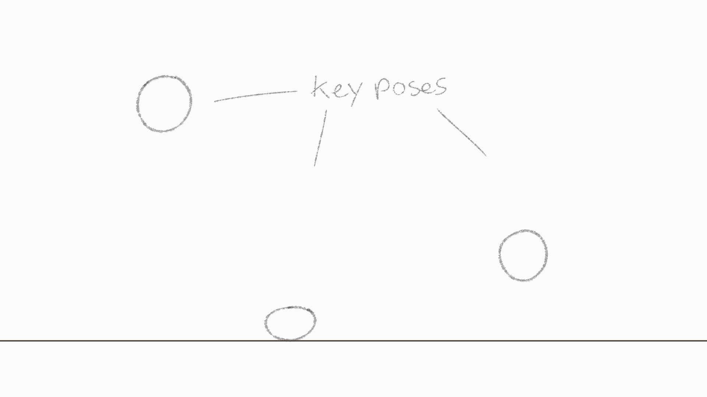
Basic Animation Essentials
Spacing
Timing
Ease in and out
Pose to pose vs Straight ahead

Slide 7
How to Assemble Flip book
Choose how many frames/paper you want to animate with
Draw on the paper with the sharp edge on the right or if you are left handed reverse this
Add small numbers to organize the paper order (optional)
Assemble papers together and add two or one paper clips on the fuzzy edges
If you have run out of paper, you can use the opposite side to make another flip book

Slide 8
10 Prompts
Up to you now! Draw and have fun
If you don’t have ideas here are 10 prompts to use as reference.
Multiple ball bounces
Chopping an object
Spinning starlights
Object or objects falling
Object popping
Object waving
Abstract shapes moving
Object shattering
Character walking or running

